Slide 1
An Introduction to Parallel Programming
Peter Pacheco
Chapter 4
Shared Memory Programming with Pthreads
Copyright © 2010, Elsevier Inc. All rights Reserved
Notes:
The University of Adelaide, School of Computer Science
Chapter 2 — Instructions: Language of the Computer

Slide 2
Roadmap
What a shared system looks like
Why and what types of threads we will use
What is a Thread?
Where to find threads?
Process vs Threads
Programming with POSIX threads.
  Passing a number to thread
  Passing an array to a thread
  Passing an structure to a thread
  Joining threads
# Chapter Subtitle
Copyright © 2010, Elsevier Inc. All rights Reserved
Notes:
The University of Adelaide, School of Computer Science
Chapter 2 — Instructions: Language of the Computer

Slide 3
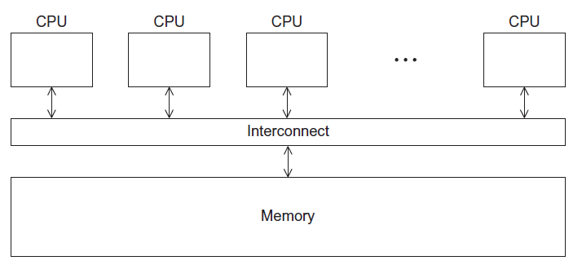
A Shared Memory System
Copyright © 2010, Elsevier Inc. All rights Reserved

Slide 4
Why and what types of threads we will use
Why?: In shared memory multiprocessor architectures, threads can be used to implement parallelism.
Which one?: For UNIX systems, a standardized C language threads programming interface has been specified by the IEEE POSIX 1003.1c standard. Implementations that adhere to this standard are referred to as POSIX threads, or Pthreads.
Copyright © 2010, Elsevier Inc. All rights Reserved

Slide 5
What is a Thread
Technically, a thread is defined as an independent stream of instructions that can be scheduled to run as such by the operating system
Imagine a main program (a.out) that contains a number of procedures. Then imagine all of these procedures being able to be scheduled to run simultaneously and/or independently by the operating system. That would describe a "multi-threaded" program.
Copyright © 2010, Elsevier Inc. All rights Reserved

Slide 6
Let’s talk Processes before we talk about Threads
A process is created by the operating system, and requires a fair amount of "overhead". Processes contain information about program resources and program execution state, including:
  Process ID, process group ID, user ID, and group ID
  Environment
  Working directory.
  Program instructions
  Registers
  Stack
  Heap
  File descriptors
  Signal actions
  Shared libraries
  Inter-process communication tools (such as message queues, pipes, semaphores, or shared memory).
Copyright © 2010, Elsevier Inc. All rights Reserved

Slide 7
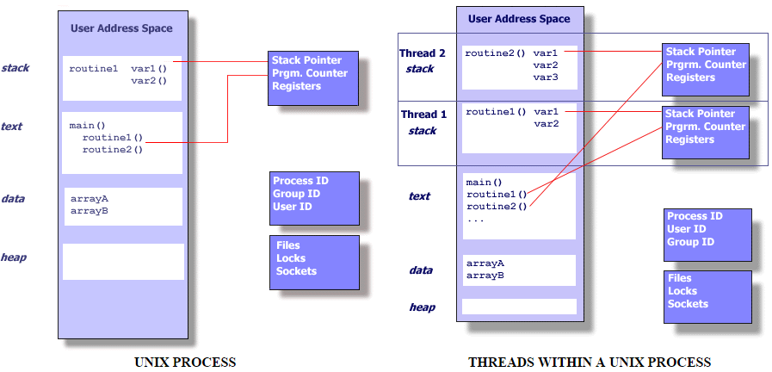
Unix: Process VS Thread
Copyright © 2010, Elsevier Inc. All rights Reserved

Slide 8
More about pthreads
Threads use and exist within these process resources, yet are able to be scheduled by the operating system and run as independent entities largely because they duplicate only the bare essential resources that enable them to exist as executable code.
This independent flow of control is accomplished because a thread maintains its own:
Stack pointer
Registers
Scheduling properties (such as policy or priority)
Set of pending and blocked signals
Thread specific data.
Copyright © 2010, Elsevier Inc. All rights Reserved

Slide 9
More about pthreads
In summary, in the UNIX environment a thread → Exists within a process and uses the process resources AND …
Has its own independent flow of control as long as its parent process exists and the OS supports it
Duplicates only the essential resources it needs to be independently schedulable
May share the process resources with other threads that act equally independently (and dependently)
Dies if the parent process dies - or something similar
Is "lightweight" because most of the overhead has already been accomplished through the creation of its process.
Copyright © 2010, Elsevier Inc. All rights Reserved

Slide 10
Keep this in mind
Because threads within the same process share resources:
Changes made by one thread to shared system resources (such as closing a file) will be seen by all other threads.
Two pointers having the same value point to the same data.
Reading and writing to the same memory locations is possible, and therefore requires explicit synchronization by the programmer.
Copyright © 2010, Elsevier Inc. All rights Reserved

Slide 11
Processes and Threads
A process is an instance of a running (or suspended) program.
Threads are analogous to a “light-weight” process.
(why ?)
  When compared to the cost of creating and managing a process, a thread can be created with much less operating system overhead. Managing threads requires fewer system resources than managing processes.
In a shared memory program a single process may have multiple threads of control.
Copyright © 2010, Elsevier Inc. All rights Reserved

Slide 12
POSIX® Threads
Also known as Pthreads.
A standard for Unix-like operating systems.
A library that can be linked with C programs.
Specifies an application programming interface (API) for multi-threaded programming.
Copyright © 2010, Elsevier Inc. All rights Reserved

Slide 13

Caveat
The Pthreads API is only available on POSIXR systems — Linux, MacOS X, Solaris, HPUX, …
Copyright © 2010, Elsevier Inc. All rights Reserved

Slide 14
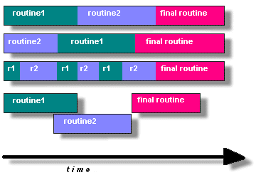
Candidates for pthreads
Programs having the following characteristics may be well suited for pthreads:
Work that can be executed, or data that can be operated on, by multiple tasks simultaneously:
Block for potentially long I/O waits
Use many CPU cycles in some places but not others
Must respond to asynchronous events
Some work is more important than other work (priority interrupts)
Copyright © 2010, Elsevier Inc. All rights Reserved

Slide 15
Common models for threaded programs
Manager/worker: a single thread, the manager assigns work to other threads, the workers. Typically, the manager handles all input and parcels out work to the other tasks.
Pipeline: a task is broken into a series of sub-operations, each of which is handled in series, but concurrently, by a different thread. An automobile assembly line best describes this model.
Peer: similar to the manager/worker model, but after the main thread creates other threads, it participates in the work.
Copyright © 2010, Elsevier Inc. All rights Reserved

Slide 16
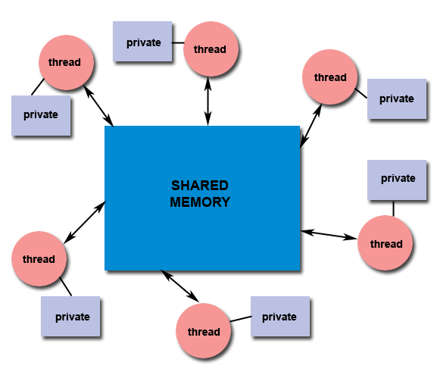
Shared Memory Model
All threads have access to the same global, shared memory
Threads also have their own private data
Programmers are responsible for synchronizing access (protecting) globally shared data.
Copyright © 2010, Elsevier Inc. All rights Reserved

Slide 17
Creating Threads
Initially, your main() program comprises a single, default thread. All other threads must be explicitly created by the programmer.
pthread_create creates a new thread and makes it executable. This routine can be called any number of times from anywhere within your code.
pthread_create arguments:
thread: An opaque, unique identifier for the new thread returned by the subroutine.
attr: An opaque attribute object that may be used to set thread attributes. You can specify a thread attributes object, or NULL for the default values.
start_routine: the C routine that the thread will execute once it is created.
arg: A single argument that may be passed to start_routine. It must be passed by reference as a pointer cast of type void. NULL may be used if no argument is to be passed.
The maximum number of threads that may be created by a process is implementation dependent. Programs that attempt to exceed the limit can fail or produce wrong results
Copyright © 2010, Elsevier Inc. All rights Reserved

Slide 18
Terminating Threads & pthread_exit():
There are several ways in which a thread may be terminated:
The thread returns normally from its starting routine. Its work is done.
The thread makes a call to the pthread_exit subroutine - whether its work is done or not.
The thread is canceled by another thread via the pthread_cancel routine
The entire process is terminated due to making a call to either the exec() or exit()
If main() finishes first, without calling pthread_exit explicitly itself
Copyright © 2010, Elsevier Inc. All rights Reserved

Slide 19
Terminating Threads & pthread_exit():
The pthread_exit() routine allows the programmer to specify an optional termination status parameter. This optional parameter is typically returned to threads "joining" the terminated thread (covered later).
In subroutines that execute to completion normally, you can often dispense with calling pthread_exit() - unless, of course, you want to pass the optional status code back.
Cleanup: the pthread_exit() routine does not close files; any files opened inside the thread will remain open after the thread is terminated.
Copyright © 2010, Elsevier Inc. All rights Reserved

Slide 20
Terminating Threads & pthread_exit():
Discussion on calling pthread_exit() from main():
There is a definite problem if main() finishes before the threads it spawned if you don't call pthread_exit() explicitly. All of the threads it created will terminate because main() is done and no longer exists to support the threads.
By having main() explicitly call pthread_exit() as the last thing it does, main() will block and be kept alive to support the threads it created until they are done.
Copyright © 2010, Elsevier Inc. All rights Reserved

Slide 21
Compiling a Pthread program (option 1)
gcc −g −Wall −o pth_hello pth_hello.c −lpthread
link in the Pthreads library
Copyright © 2010, Elsevier Inc. All rights Reserved

Slide 22
Compiling (Option 2)
gcc FileName.c -o ExecutableName -lpthread
Copyright © 2010, Elsevier Inc. All rights Reserved

Slide 23
Let’s go for some code
Pthread Creation and Termination
PthreadsEx1
This simple example code creates 5 threads with the pthread_create() routine.
Each thread prints a "Hello World!" message, and then terminates with a call to pthread_exit().
Copyright © 2010, Elsevier Inc. All rights Reserved

Slide 24
Let’s go for some code
Thread Argument Passing
PthreadsEx2
This code fragment demonstrates how to pass a simple integer to each thread.
The calling thread uses a unique data structure for each thread, insuring that each thread's argument remains intact throughout the program.
Copyright © 2010, Elsevier Inc. All rights Reserved

Slide 25
Let’s go for some code
Thread Argument Passing
PthreadsEx3
This example shows how to setup/pass multiple arguments via a structure. Each thread receives a unique instance of the structure.
Copyright © 2010, Elsevier Inc. All rights Reserved

Slide 26

Global variables
Can introduce subtle and confusing bugs!
Limit use of global variables to situations in which they’re really needed.
  Shared variables.
Copyright © 2010, Elsevier Inc. All rights Reserved

Slide 27
Starting the Threads
Processes in MPI are usually started by a script.
In Pthreads the threads are started by the program executable.
Copyright © 2010, Elsevier Inc. All rights Reserved

Slide 28
Starting the Threads
pthread.h
One object for each thread.
pthread_t
int pthread_create (
pthread_t* thread_p /* out */ ,
const pthread_attr_t* attr_p /* in */ ,
void* (*start_routine ) ( void ) /* in */ ,
void* arg_p /* in */ ) ;
Copyright © 2010, Elsevier Inc. All rights Reserved

Slide 29
pthread_t objects
Opaque
The actual data that they store is system-specific.
Their data members aren’t directly accessible to user code.
However, the Pthreads standard guarantees that a pthread_t object does store enough information to uniquely identify the thread with which it’s associated.
Copyright © 2010, Elsevier Inc. All rights Reserved

Slide 30
A closer look (1)
int pthread_create (
pthread_t* thread_p /* out */ ,
const pthread_attr_t* attr_p /* in */ ,
void* (*start_routine ) ( void ) /* in */ ,
void* arg_p /* in */ ) ;
We won’t be using, so we just pass NULL.
Allocate before calling.
Copyright © 2010, Elsevier Inc. All rights Reserved

Slide 31
A closer look (2)
int pthread_create (
pthread_t* thread_p /* out */ ,
const pthread_attr_t* attr_p /* in */ ,
void* (*start_routine ) ( void ) /* in */ ,
void* arg_p /* in */ ) ;
Pointer to the argument that should
be passed to the function start_routine.
The function that the thread is to run.
Copyright © 2010, Elsevier Inc. All rights Reserved

Slide 32
Function started by pthread_create
Prototype:
void* thread_function ( void* args_p ) ;
Void* can be cast to any pointer type in C.
So args_p can point to a list containing one or more values needed by thread_function.
Similarly, the return value of thread_function can point to a list of one or more values.
Copyright © 2010, Elsevier Inc. All rights Reserved

